Slide 1

User Interface E-Gate Pass
Web Development
SFPO research

Slide 2
Feedback request | Depart | Page | Feedback Request | Depart | Page
Possible search on dropdown list | EHS, HR |  | Make category gate pass base on type of goods such as finish good & waste | HR
Possible edit gatepass after rejected | EHS |  | Add bilingual Feature | HR
Possible filtering data when generate carriage letter | EHS |  | Add Photo upload option on truck & goods | HR
Add Cost Center dropdown | EHS |  | Possible search gate pass base on type of goods | Logistic
User possible print gatepass | HR |  | Make dropdown list on type of goods for Finish goods | Logistic
General gate pass control by each depart | HR |  | Change Returned Record Table view base on type of goods | Logistic
Open
Open
Open
Open
Open
Open
Open
Open
Open
Open
Open
Open

Slide 3
Feedback request | Depart | Page
Change layout of approval invormation | Logistic
Possible manually keyin driver name | BMO
Add remark on finish good gate pass | Logistic
Possible to record returned scrap | EHS
User possible print QR code using printer thermal | Logistic
Logistic as third-person(authorizer) on returning goods flow. | HR
Open
Open
Open
Open
Open
Open

Slide 4
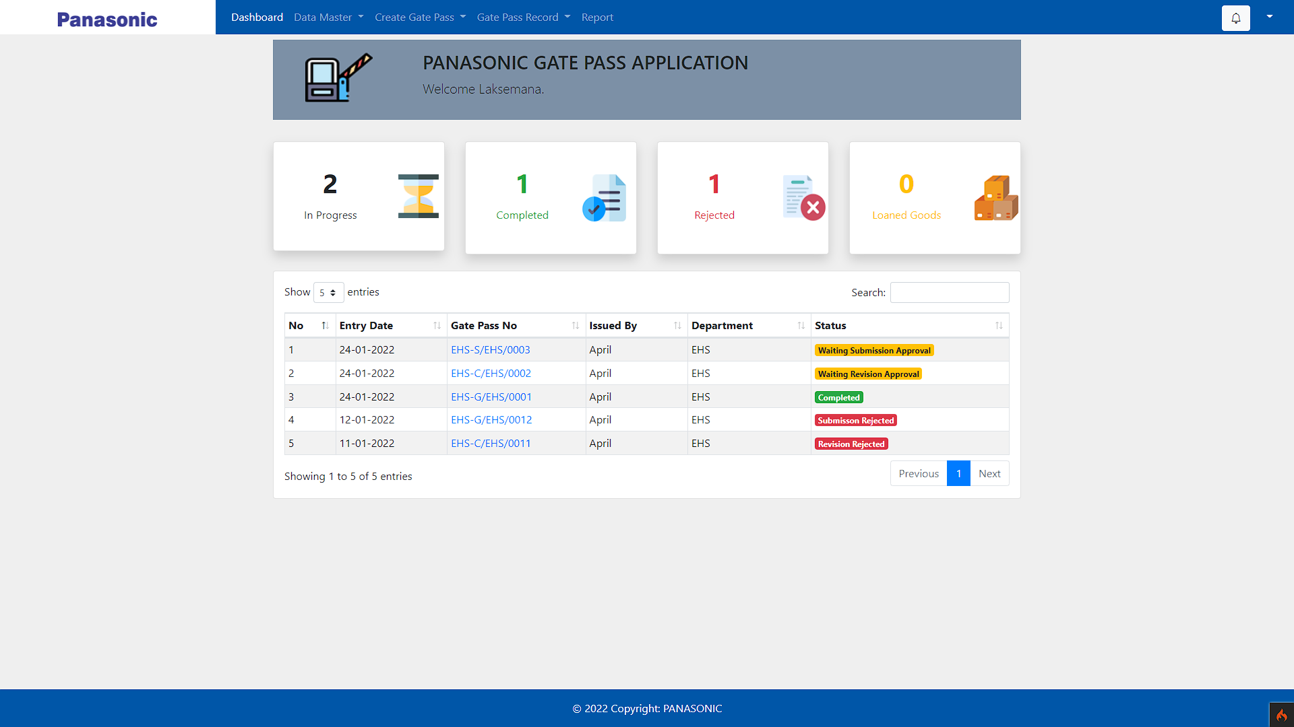
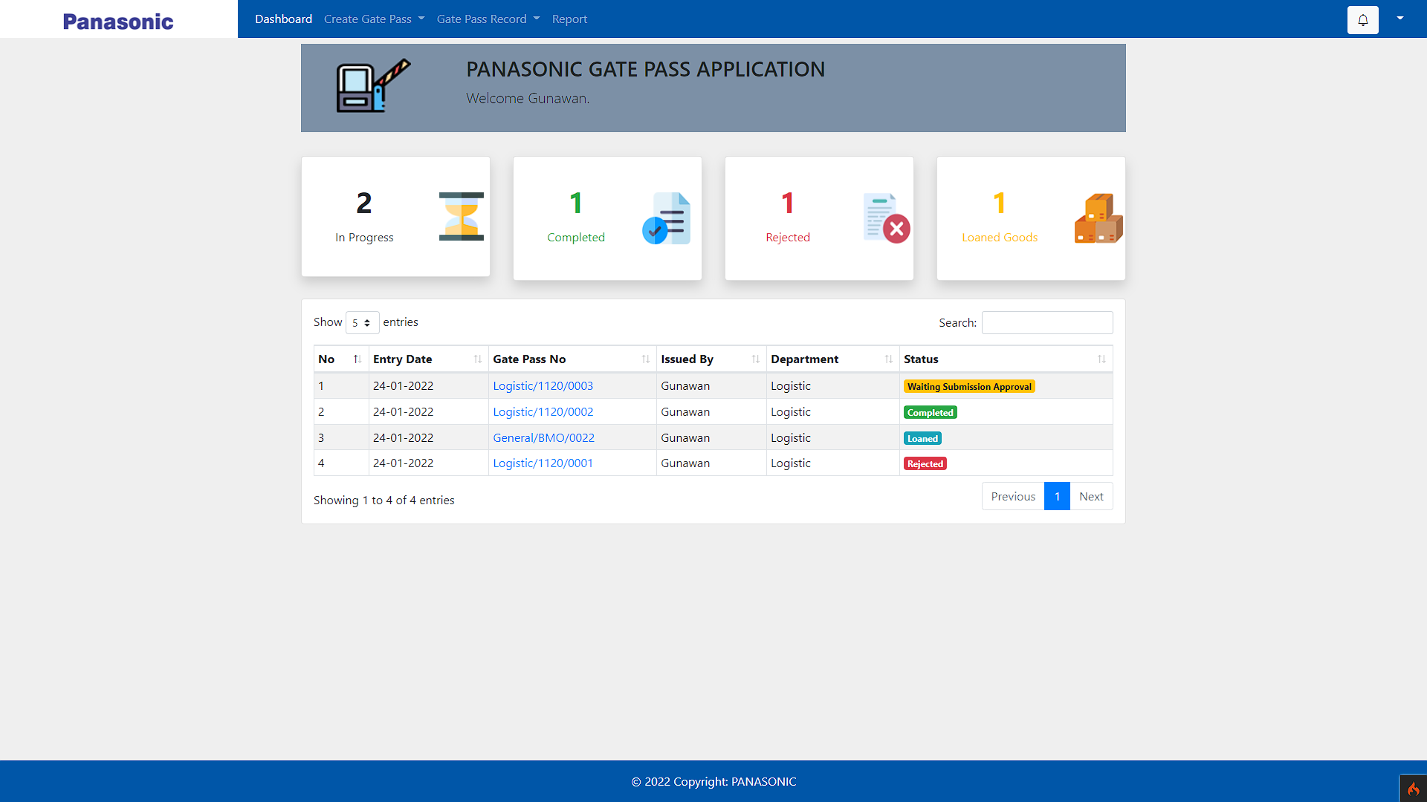
Modul Logistic

Slide 5

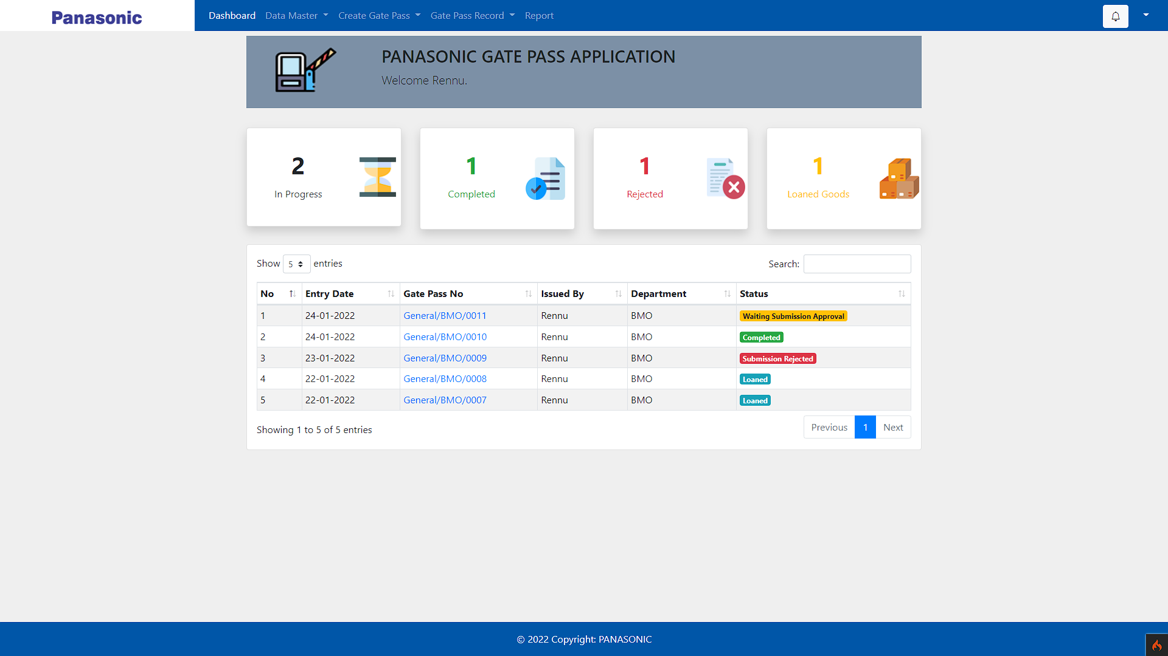
Modul BMO

Slide 6
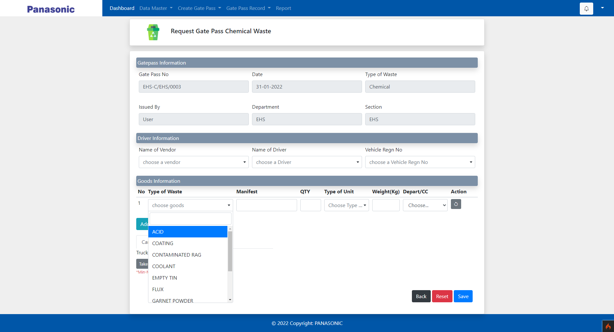
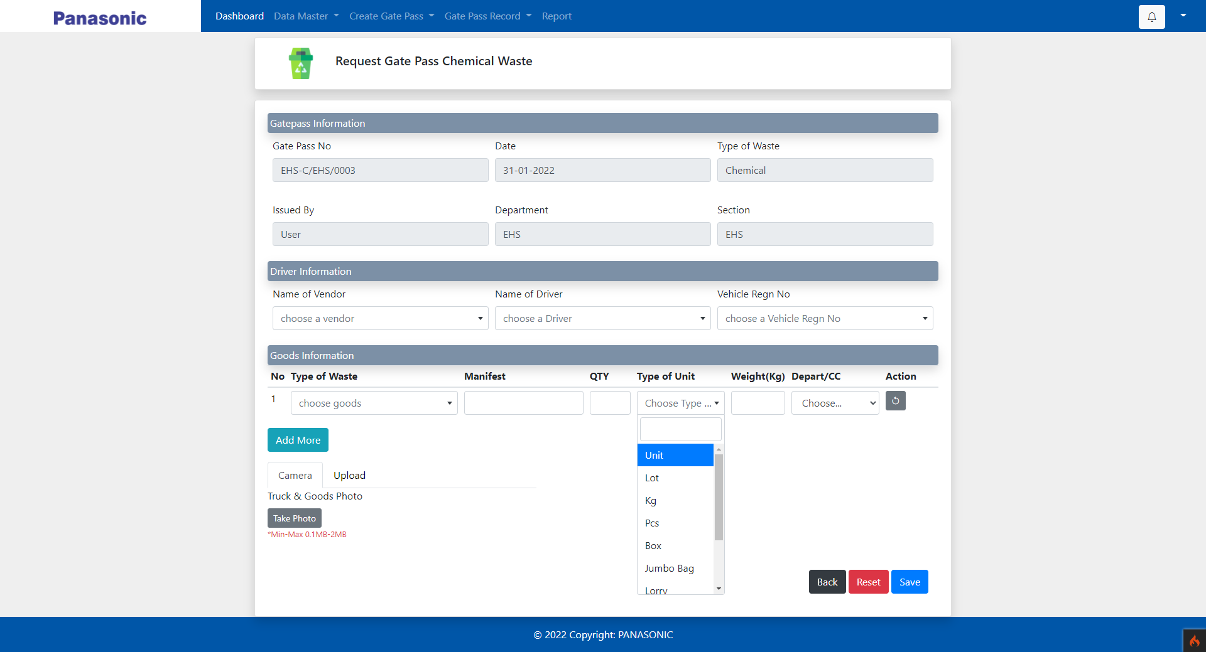
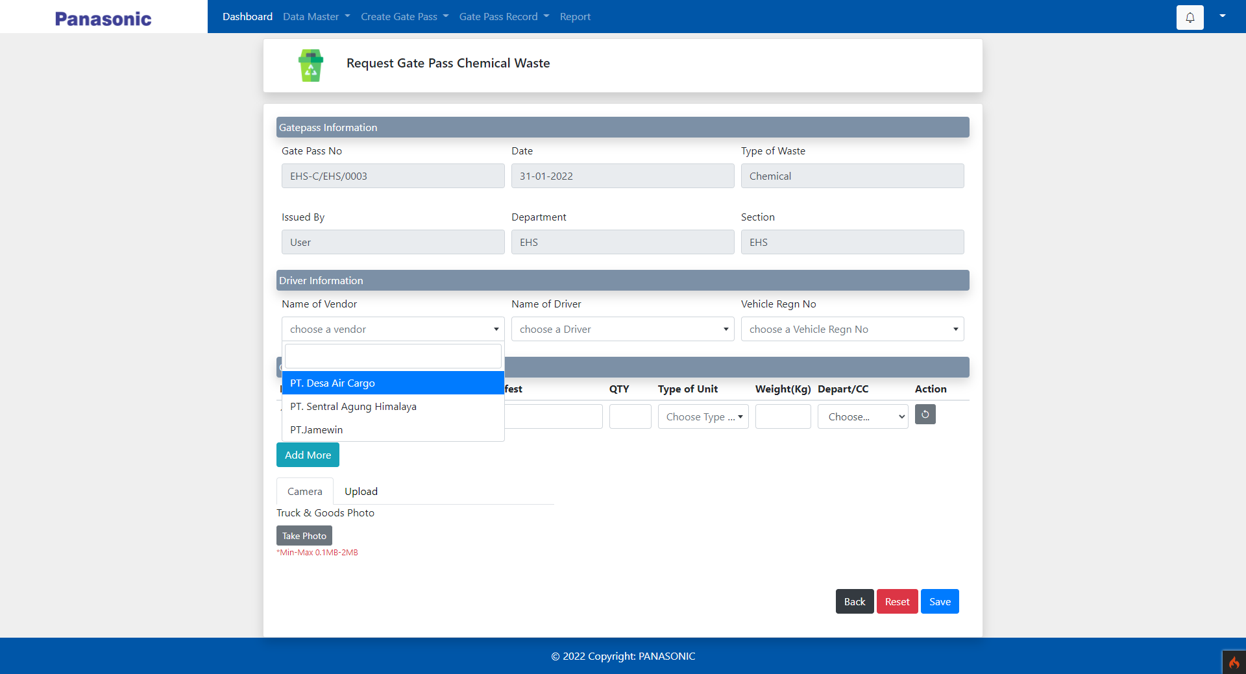
search on dropdown list

Slide 7
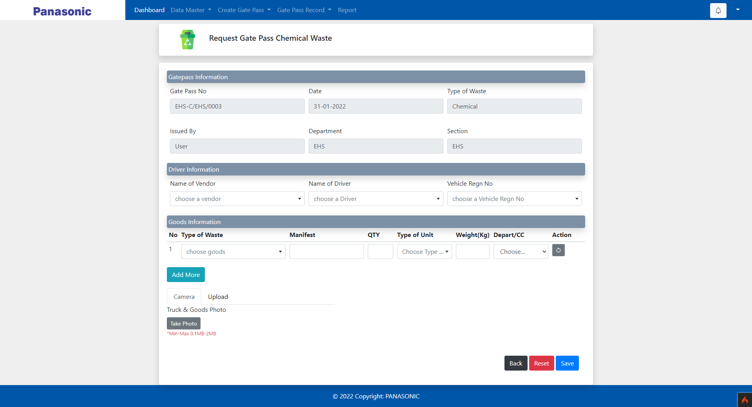
Add Photo upload option
on truck & goods

Slide 8
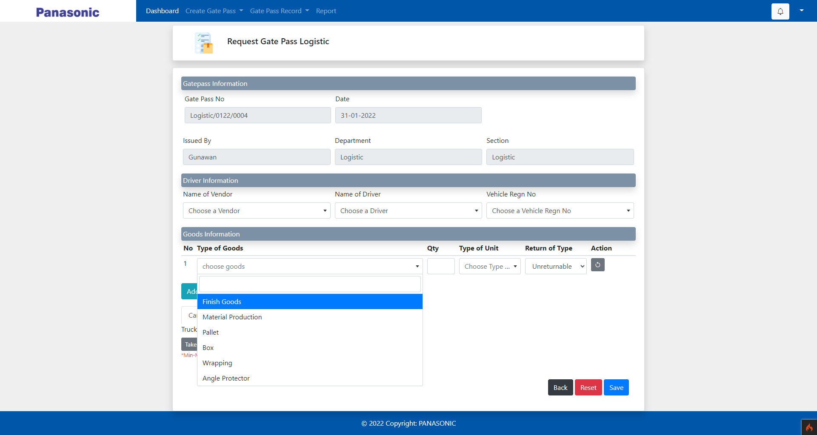
Make dropdown list on
type of goods for Finish goods

Slide 9
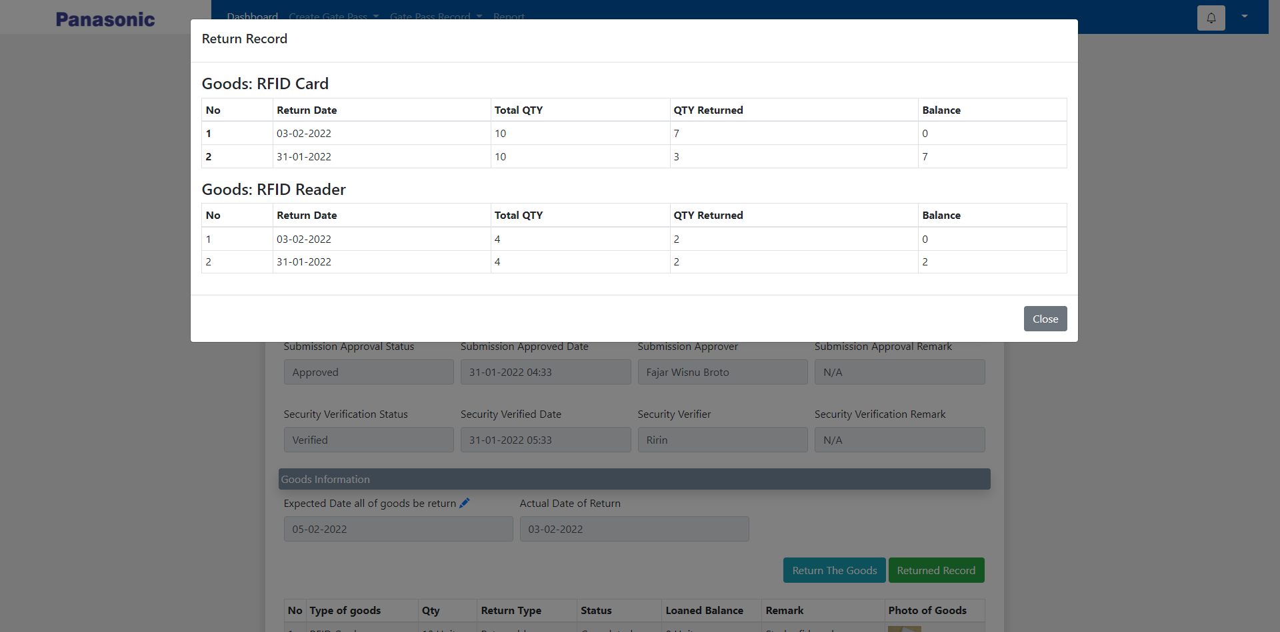
Change Returned Record Table
view base on type of goods

Slide 10
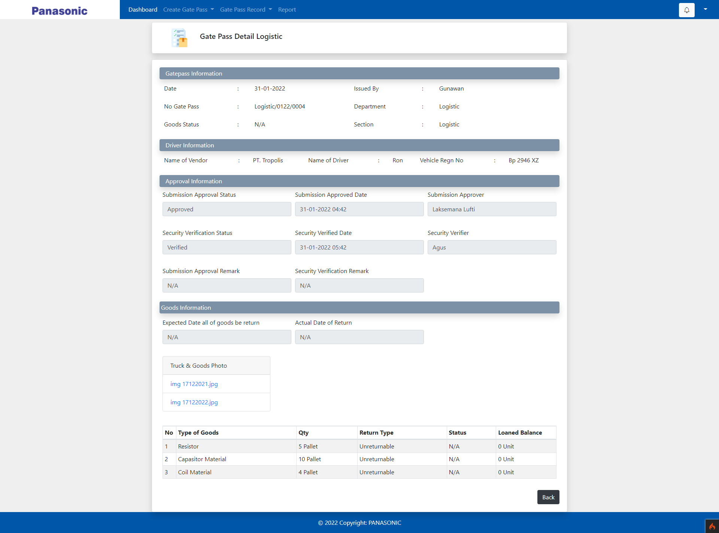
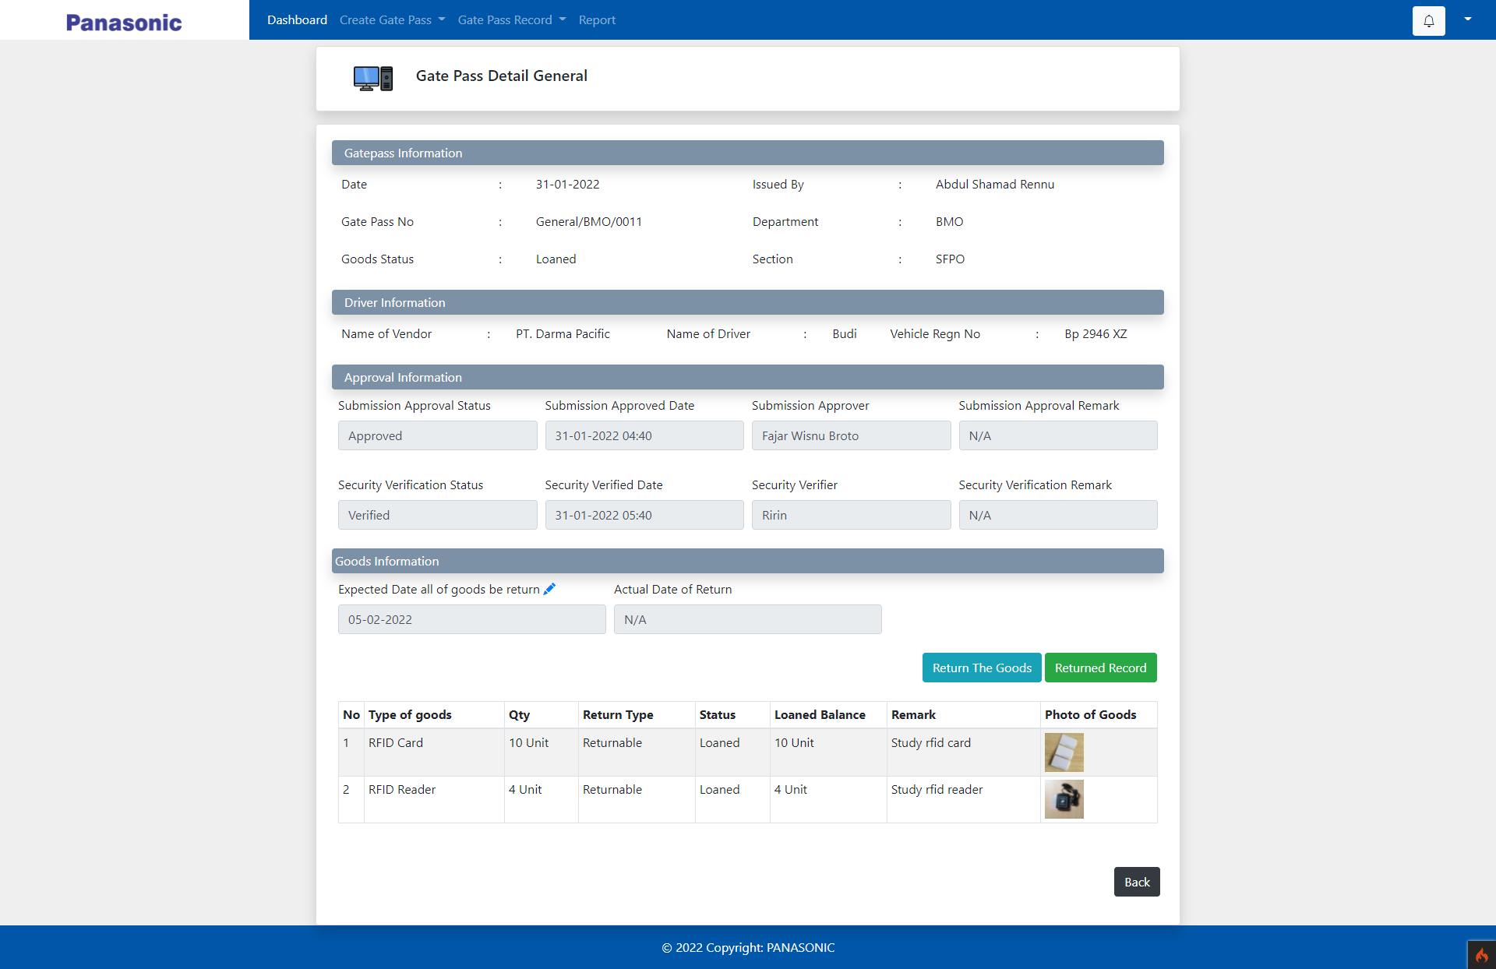
Change layout of
approval invormation

Slide 11
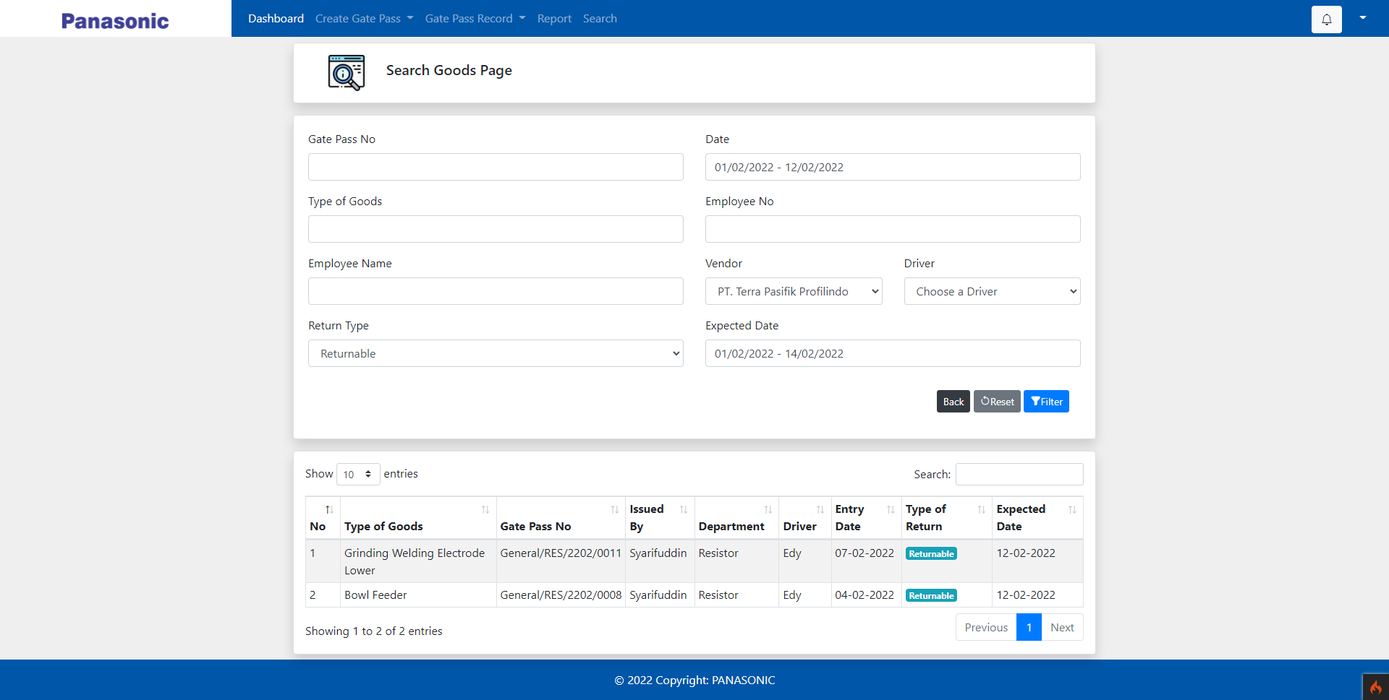
Possible search gate pass
base on type of goods

Slide 12
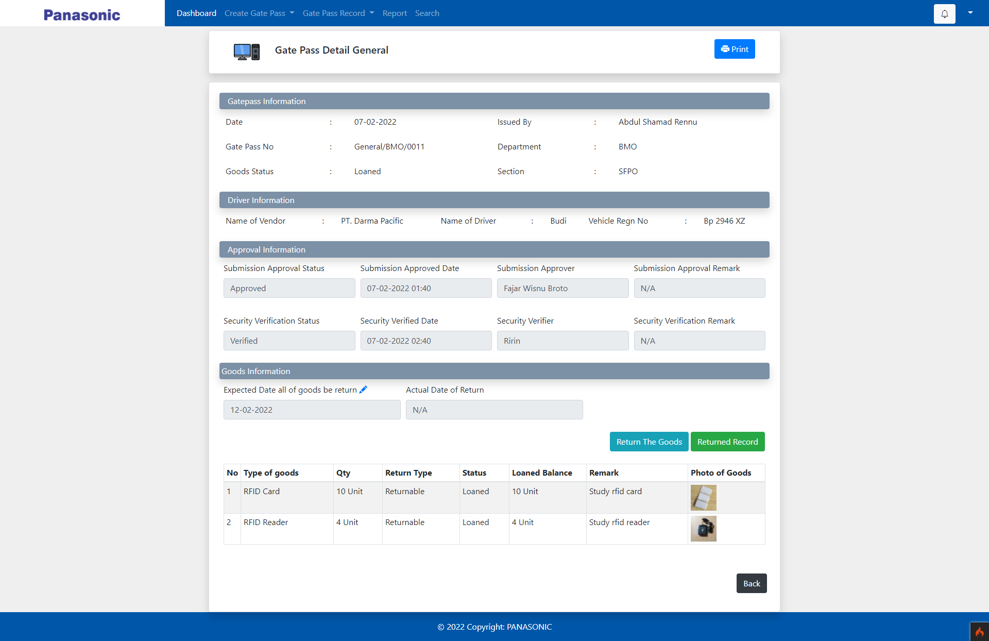
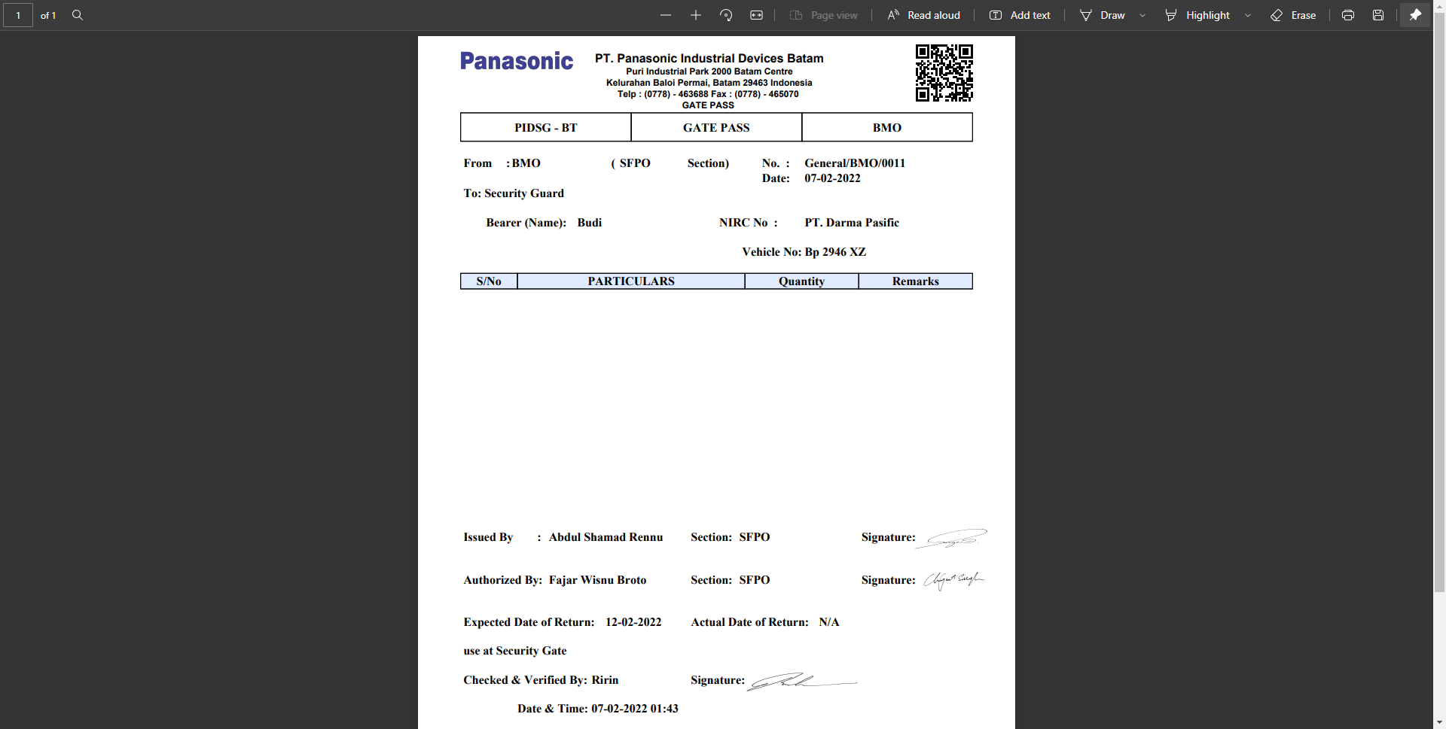
User possible print gate pass
for giving it to vendor

Slide 13
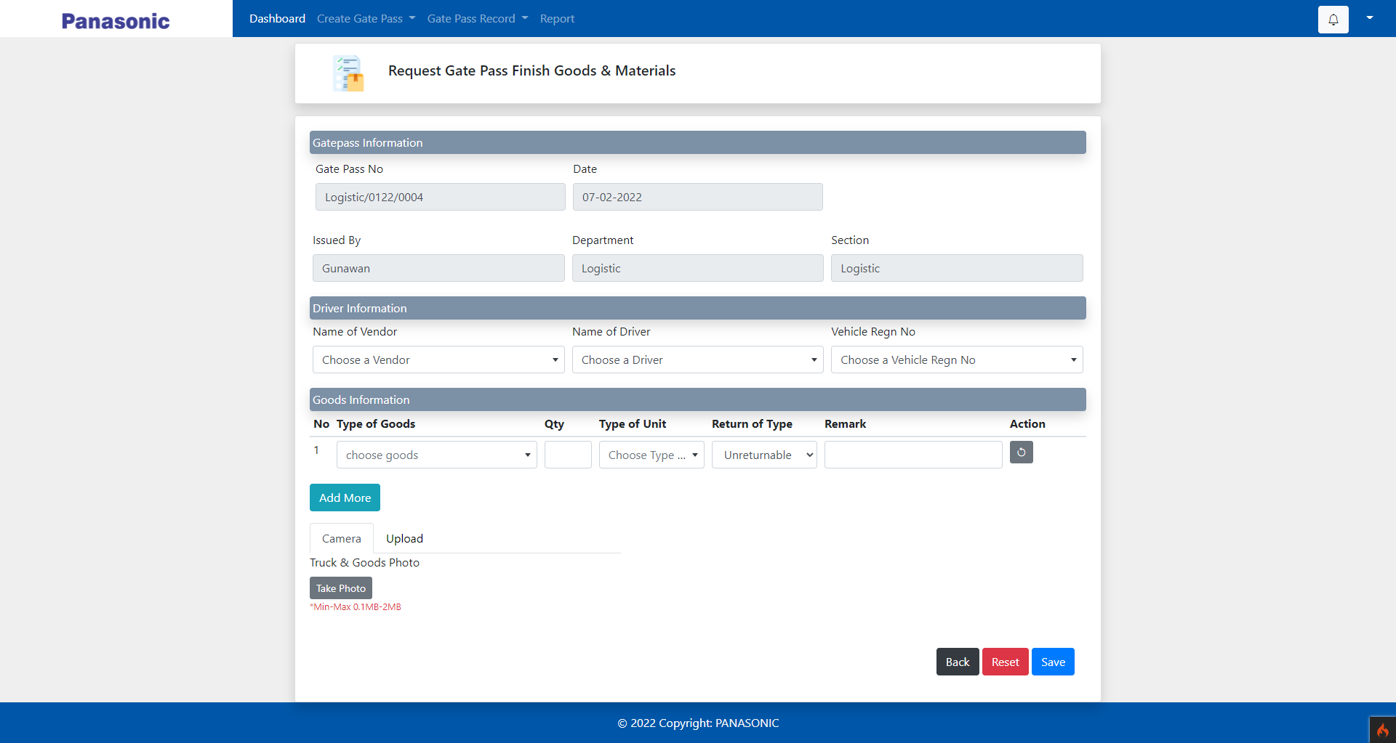
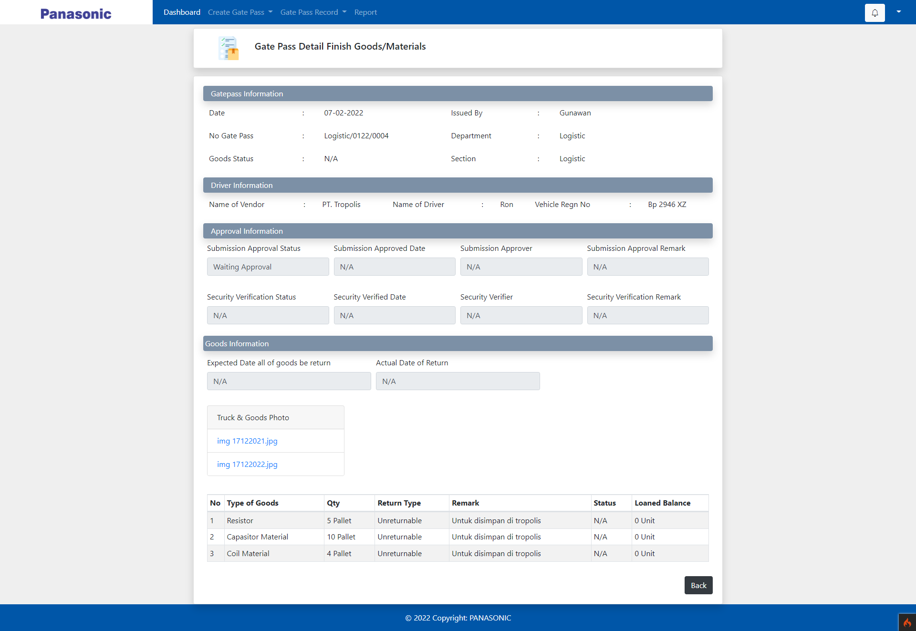
Add remark on finish good
gate pass

Slide 14
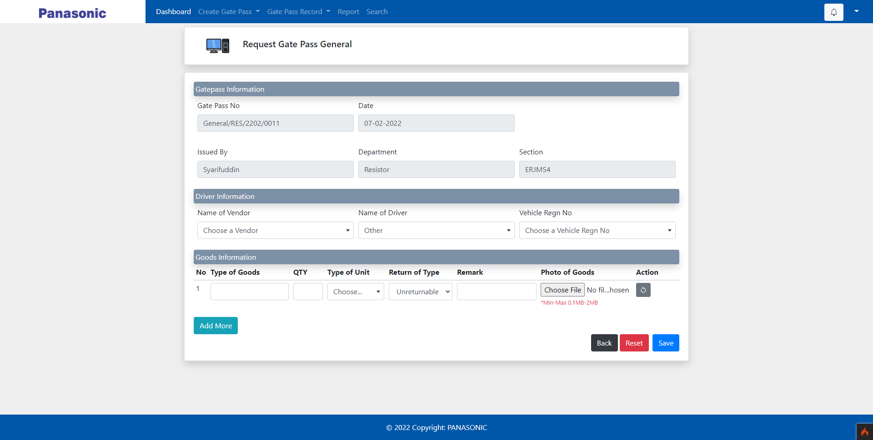
Possible manually keyin
driver name

Slide 15
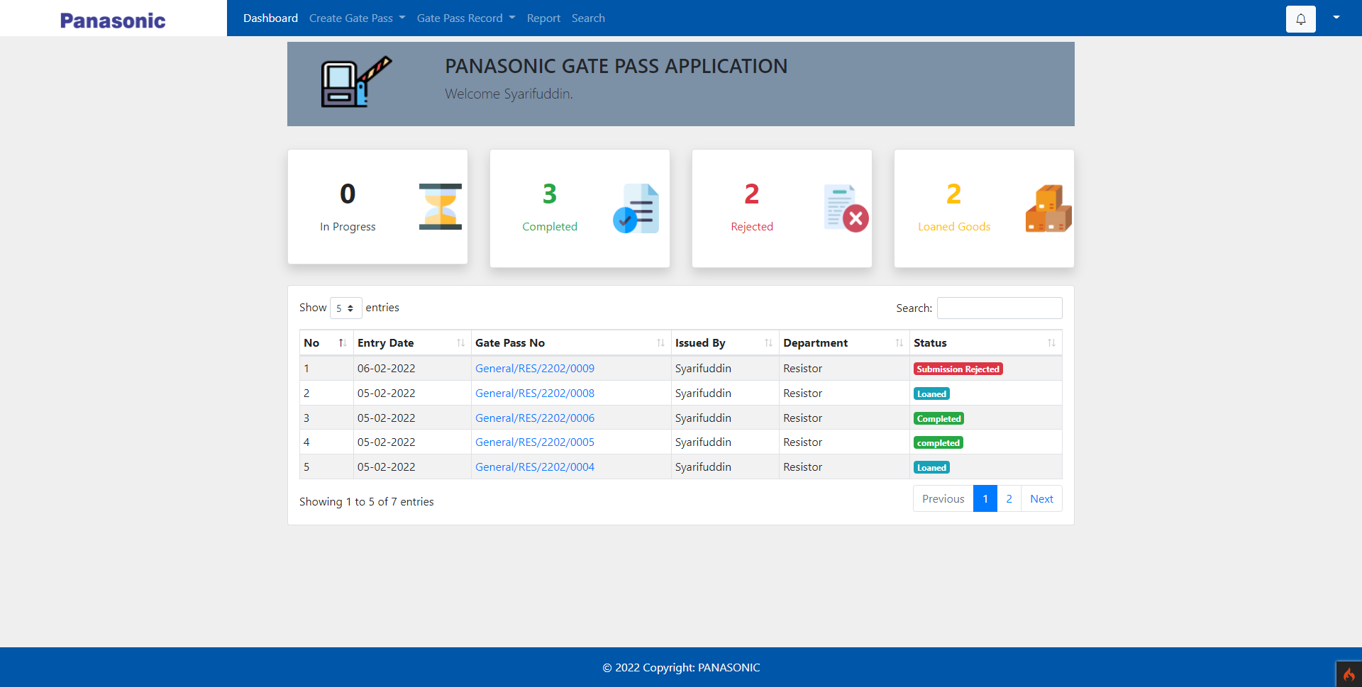
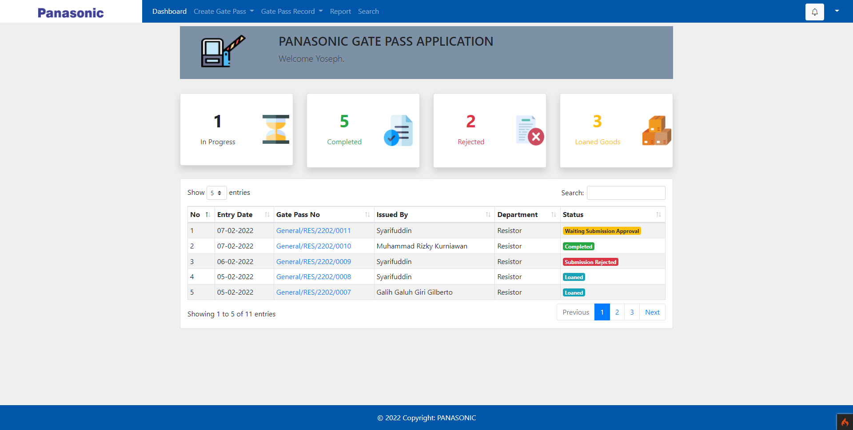
Demo Resistor

